Slide 1
topic:- Hydrological cycle mrs. Jadhav megha mahesh
Department of soil and water conservation
      KVPS
      Kisan Arts, Commerce and Science College, Parola

Slide 2
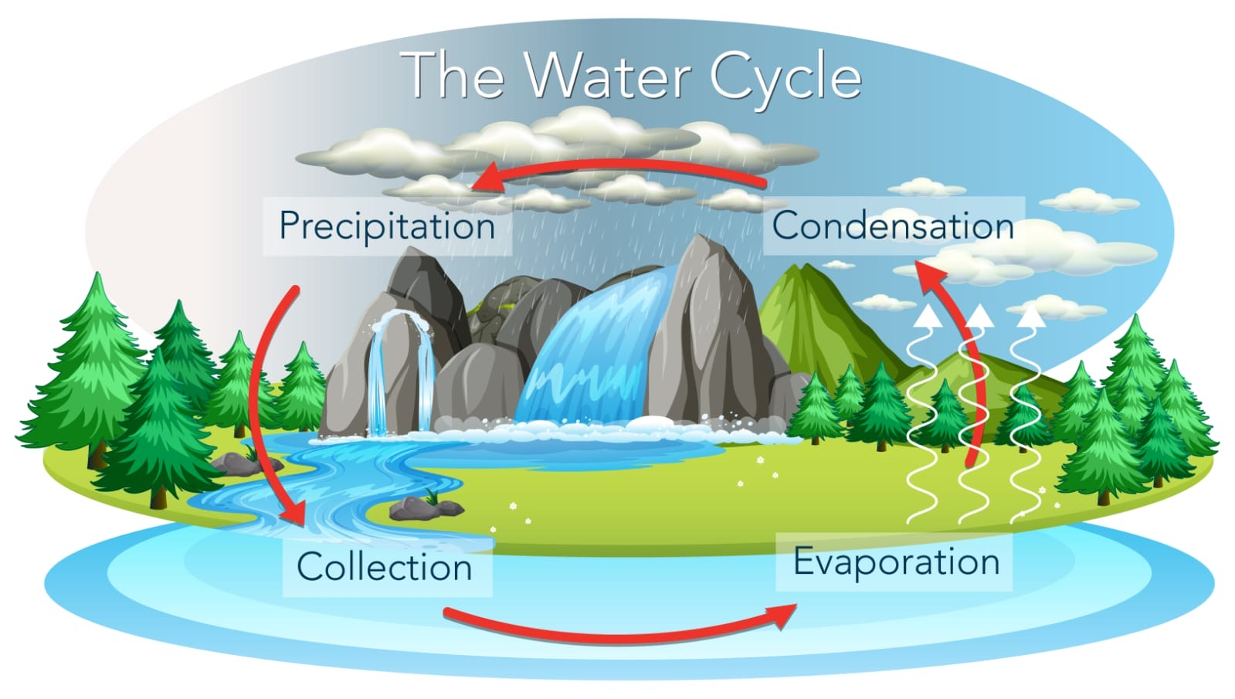
Hydrological cycle

Slide 3
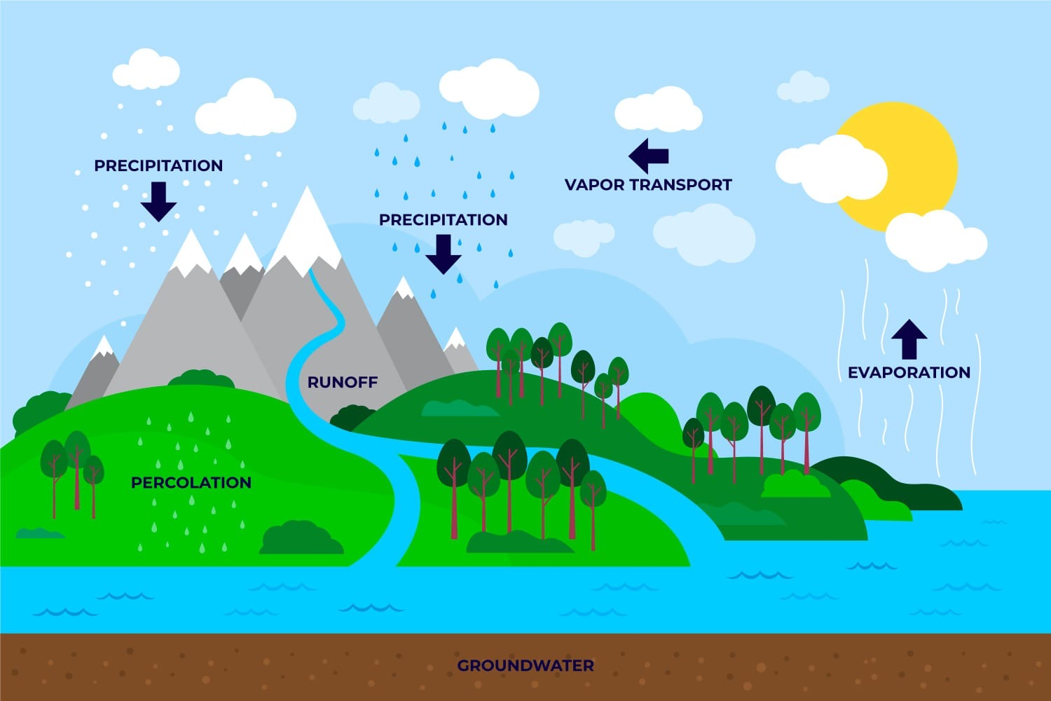

Slide 4
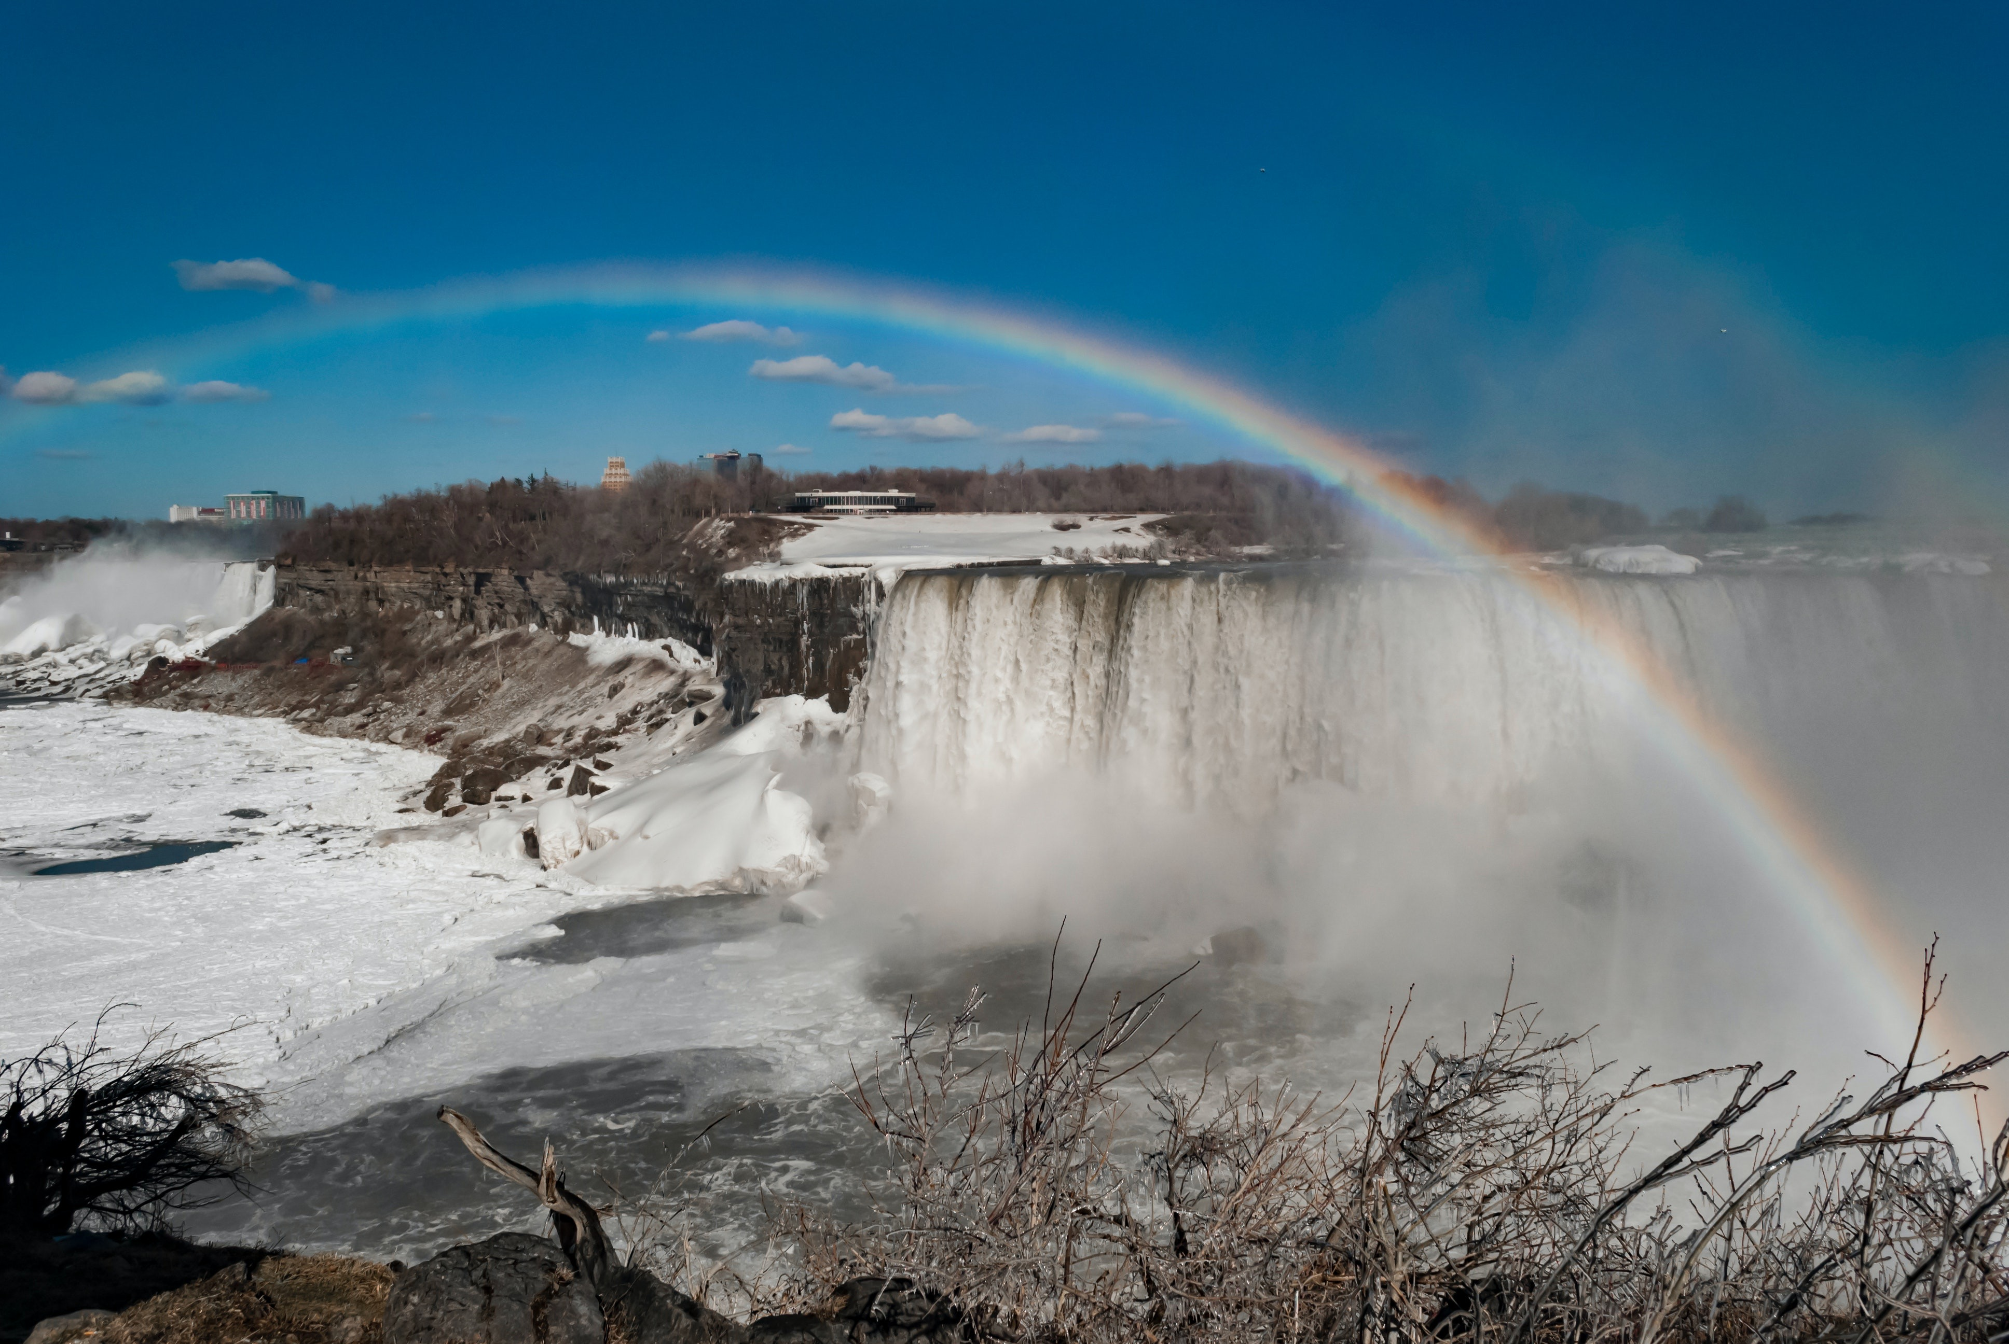
Evaporation
The process by which , the water or moisture from the water body or soil surface is removed continuously under temperature effect.

Slide 5
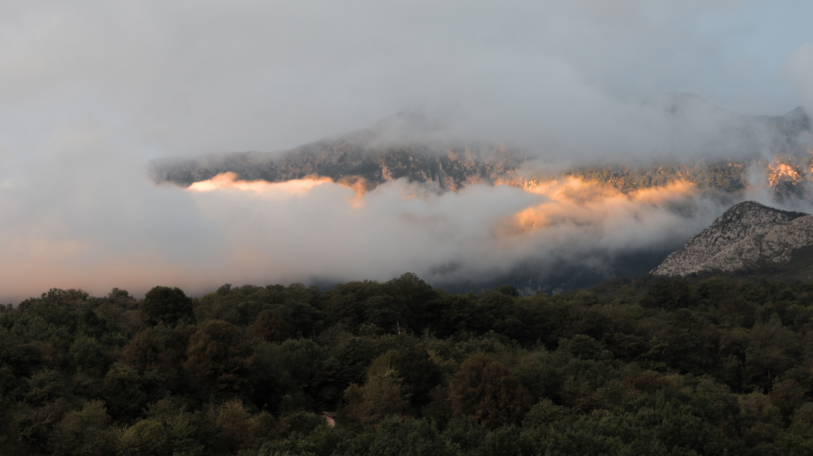
Transpiration
The water loss only from the plant’s body during respiration process.

Slide 6
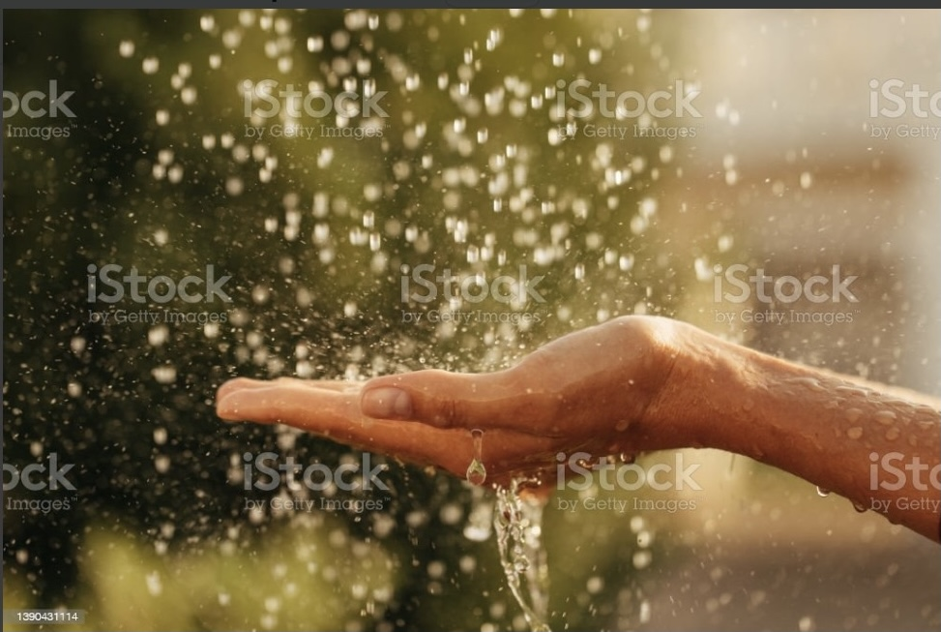
Precipitation
The process of lifting of moisture to the atmosphere and subsequently formation of clouds at the same height.
The water from the clouds falls over the earth in the form of precipitation which is circulated to the oceans, rivers, inland bodies, etc.

Slide 7
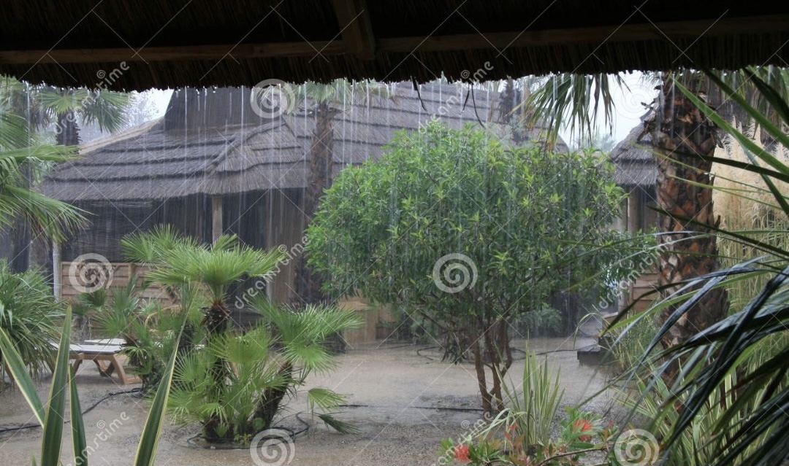
Interception loss
The part of precipitated water which is intercepted by the vegetative foliage, dry surfaces of buildings, ground surface, etc. is ultimately lost to the atmosphere.

Slide 8
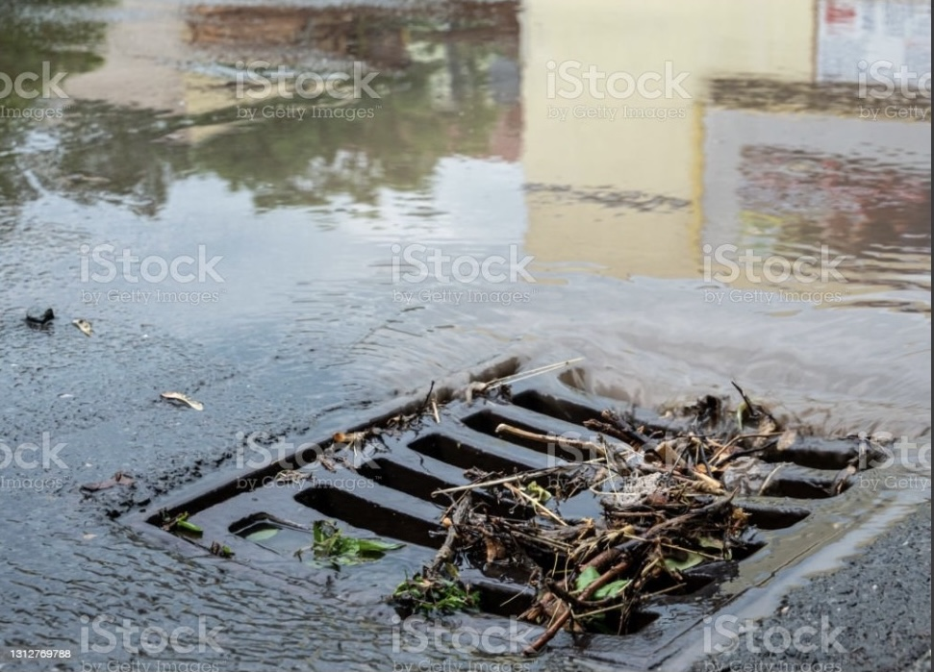
Runoff
It occurs when there is more water than land can absorb.
The water running off the land surface.
Surface runoff : The amount of precipitation goes to the streams, rivers, etc.
Sub-surface runoff : The few part of rainfall also goes down into the soil and joins to the rivers, oceans or sea is called sub-surface runoff.

Slide 9
P = R + E
P = precipitation
R = runoff
E = Losses through evaporation and transpiration
Hydrologic balance equation

Slide 10
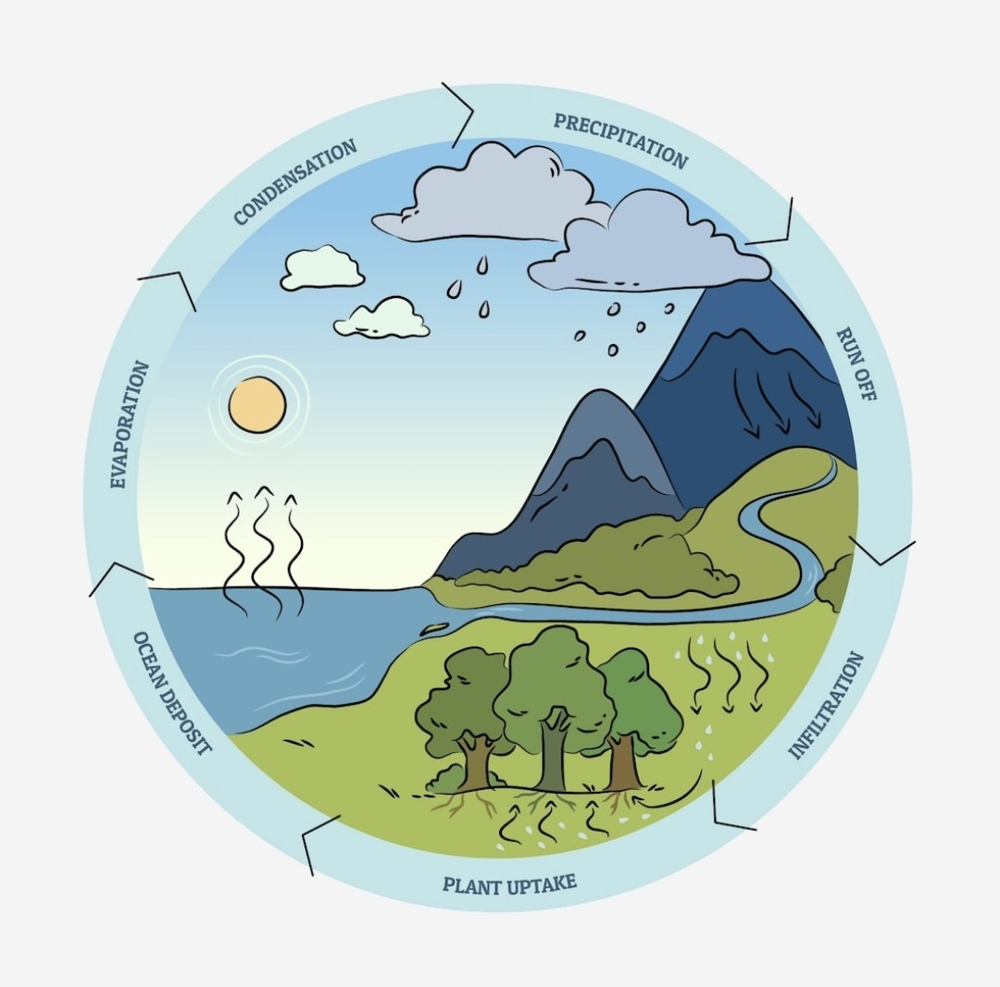

Slide 11
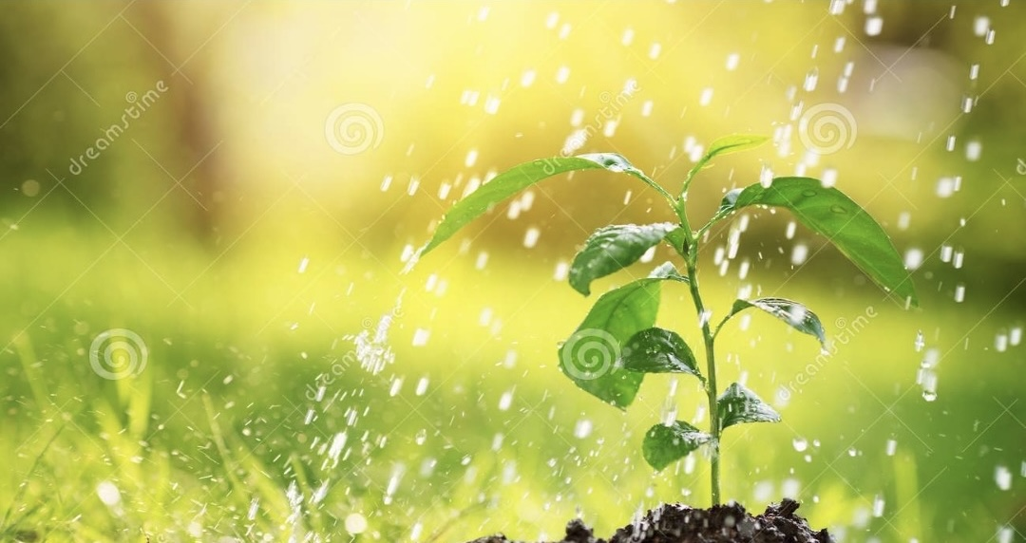
Thank you..!!

